Slide 1



UNIT 5; It takes drive
Gender (in)equality

Slide 2
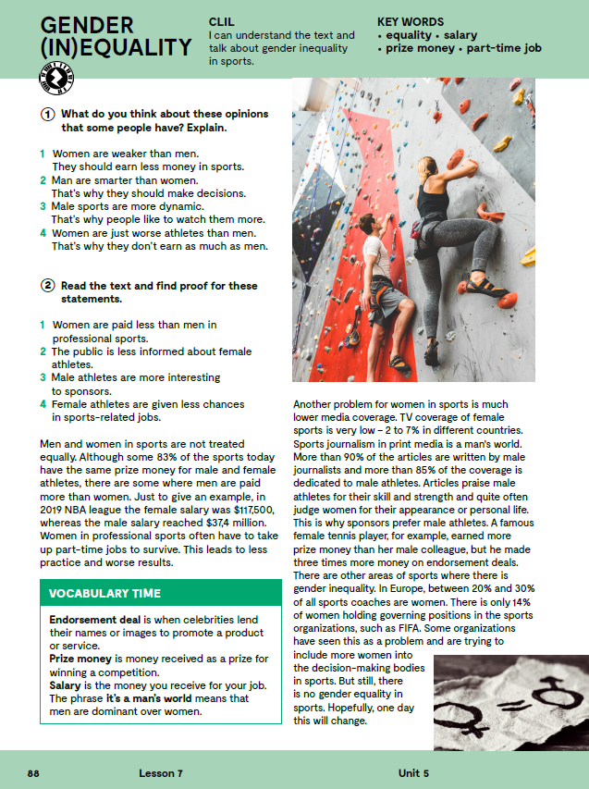
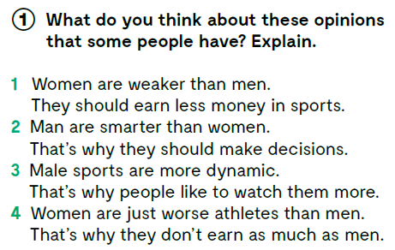

Slide 3

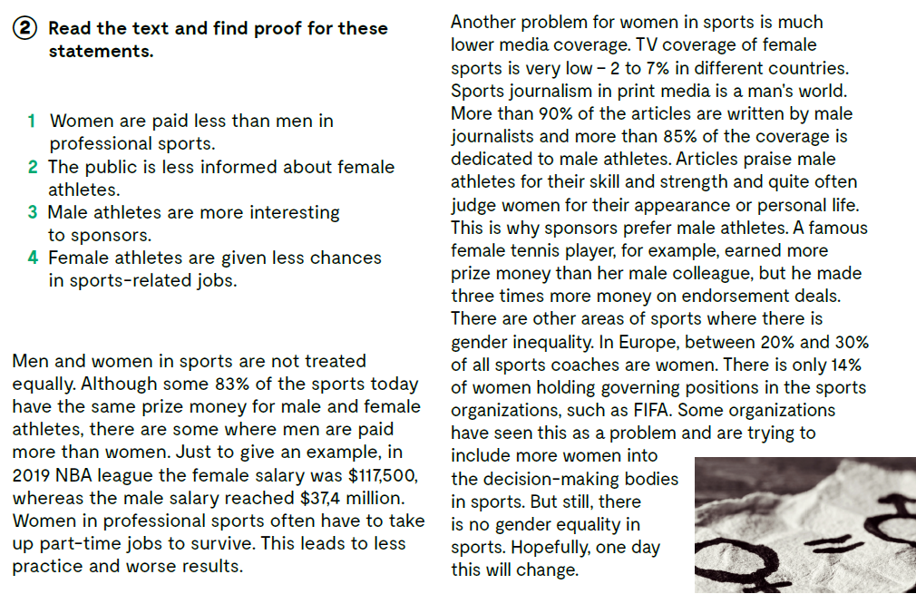

Slide 4
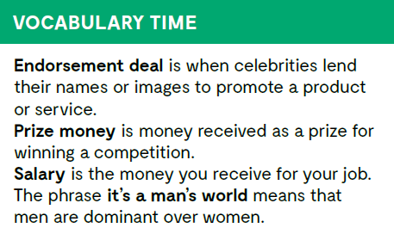
Let’s practise: https://wordwall.net/play/847/353/834

Slide 5
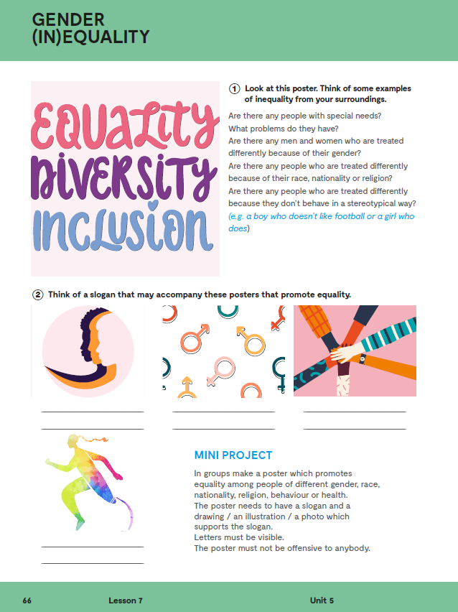

Workbook, p. 61
equality ravnopravnost, jednakost
diversity različitost
inclusion inkuluzija, uključivanje

Slide 6
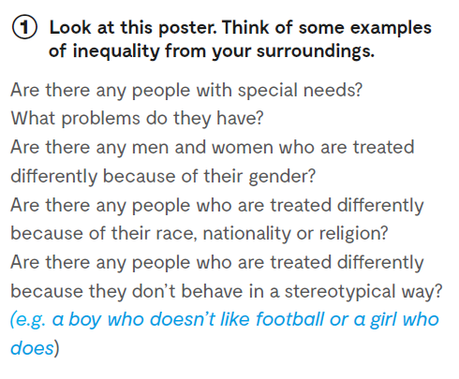

Slide 7
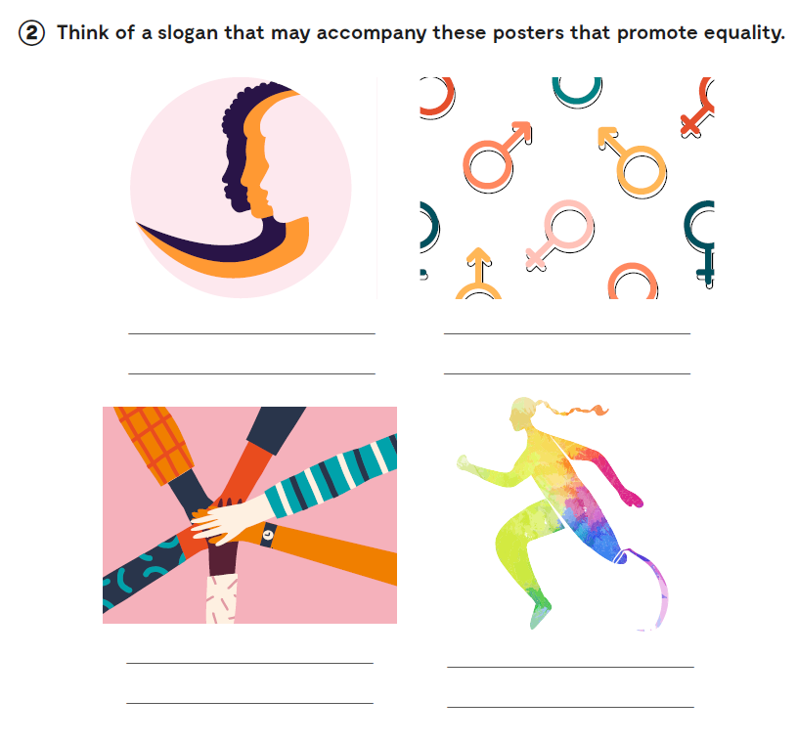

Slide 8
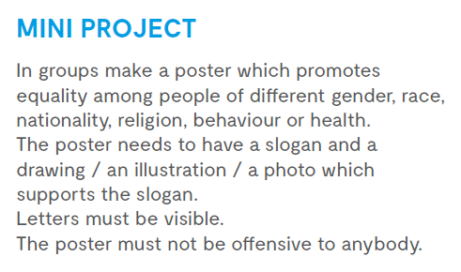

Slide 9

LEARN MORE
https://www.e-sfera.hr/dodatni-digitalni-sadrzaji/4387113c-13a5-4e41-af0e-920e4a94554f/
American women’s rights heroines

Slide 10
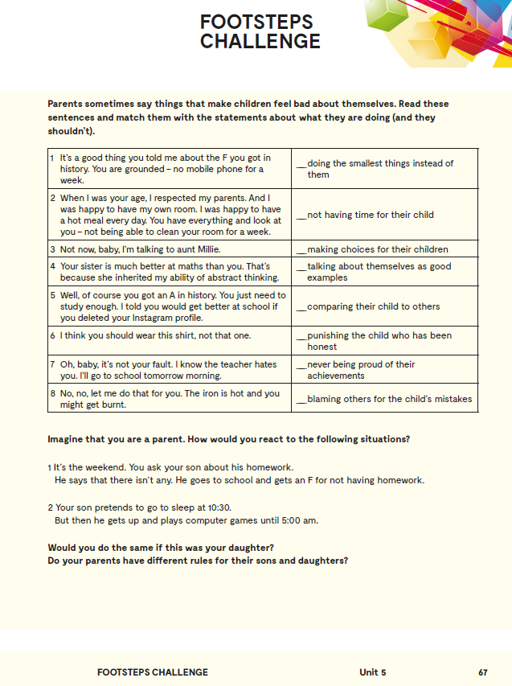
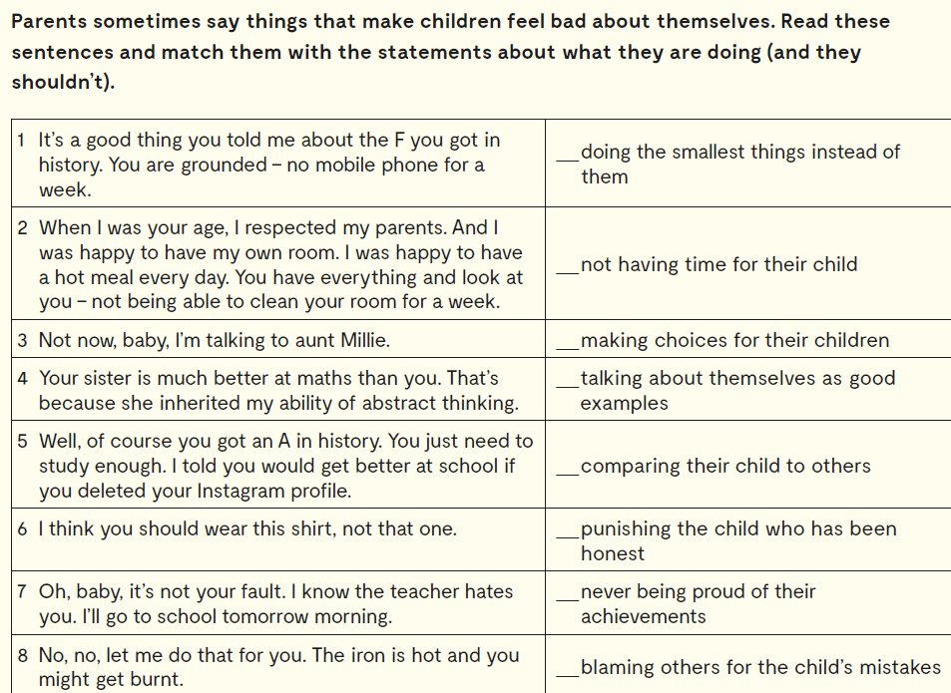
Workbook, p. 62
8
3
6
2
4
1
5
7

Slide 11

